Slide 1

Vehicle Sales & Price Insights Dashboard

Slide 2

Project Overview
Objective: To clean and analyze vehicle sales transaction data and build an interactive Excel dashboard to understand pricing trends and market behavior.

Slide 3

Dataset Description
Dataset Name: Vehicle Sales and Market Trends Dataset Contains: 10K+ vehicle transaction records
Key Columns:
Vehicle Info: year, make, model, trim, body, transmission
Usage: condition, odometer
Pricing: mmr, sellingprice
Location & seller: state, seller
Time: saledate

Slide 4
Data Cleaning & Transformation
Cleaning Steps Performed:
Removed duplicates (VIN)
Filled missing categorical values (Unknown)
Fixed datatypes (year, odometer, mmr, sellingprice)
Converted saledate into Date format
Standardized state & transmission
Feature Engineering (New Columns Created)
New Columns Added for Better Analysis:
Condition Category: Poor / Average / Good / Excellent
Mileage Band: Low / Medium / High mileage
Sale Month & Month Name for monthly trend analysis

Slide 5
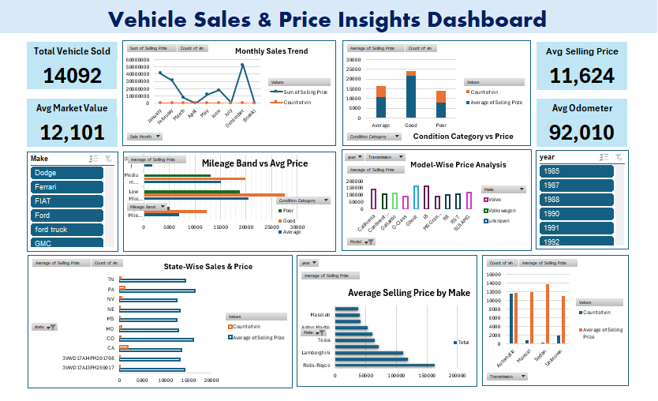

Slide 6
Key Insights & Findings
Make/Brand strongly impacts selling price (premium makes sell higher).
Low mileage + good condition vehicles have the highest prices.
High mileage / poor condition vehicles sell for less (depreciation effect).
Sales and pricing vary by state and fluctuate month-wise.
Automatic transmission vehicles dominate the market.

Slide 7

Conclusion
This dashboard proves that selling price is mainly influenced by three major factors:
Make/Brand (highest impact)
Vehicle Condition (quality impact)
Mileage/Odometer (depreciation impact)
Additionally, pricing and sales performance varies by state and shows monthly trend fluctuations, while automatic vehicles dominate market share. Overall, this dashboard helps stakeholders quickly identify high-value brands, price drivers, and market patterns for better pricing and sales decisions.

